Slide 1
Gamesale, Regional & Strategic Insights
Prepared by: Echeka Obaloluwa
Course: Data science
Date: 23, October 2026

Slide 2
Introduction- project Overview
Dataset: http://vgsales.csv - 16,598 games, 11 columns
(Rank, Name, Platform, Year, Genre, Publisher, Sales)
Columns breakdown:
- NA_Sales, EU_Sales, JP_Sales, Other_Sales, Global_Sales
Aim: Understand market performance, regional preferences,
strategic business opportunities
9 Research Questions divided into:
Market (5), Regional (3), Strategic (4)
Tools: Python Pandas, Matplotlib, Jupyter Notebook
Method: Same df as SUCCESS screenshot - NO ERROR ‎<This message was edited>

Slide 3
2. METHODOLOGY - Step by Step
Step 1: Import libraries
import pandas as pd
import matplotlib.pyplot as plt
Step 2: Load data - SUCCESS METHOD (Same as your screenshot)
file_path = r"C:\Users\HP\Downloads\vgsales.csv"
df = pd.read_csv(file_path)
print("SUCCESS! CSV loaded.")
display(df.head(10))
Step 3: Data cleaning
○ Checked missing values in Year, Publisher
○ No major errors
Step 4: Analysis
○ Used groupby: df.groupby('Platform')['Global_Sales'].sum()
○ Mean, sum, count, Z-score for outliers
Step 5: Visualization - 10 Charts
Step 6: Insights & Recommendations

Slide 4
OBJECTIVES - Link to Charts
Objectives:
Identify platforms/genres with highest sales (Charts 1,2,3)
-> Shows where to invest
Track sales trend over time (Chart 4)
-> Shows Golden Era 2005-2010
Compare regional preferences NA/EU/JP (Chart 6)
-> Shows need to localize: RPG for Japan
Find best genre-platform combos (Chart 7)
-> Shows PS2-Action, X360-Shooter best
Analyze top games & outliers (Charts 8,9)
-> Shows franchise + outlier strategy
Each chart in this project directly answers one question
from the introduction. Introduction explains WHY,
charts show WHAT, conclusion says SO WHAT. ‎<This message was edited>

Slide 5
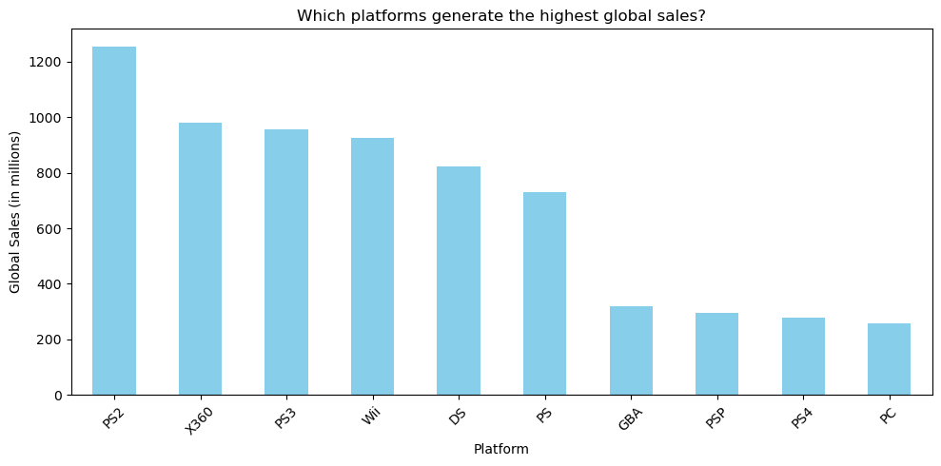

Slide 6
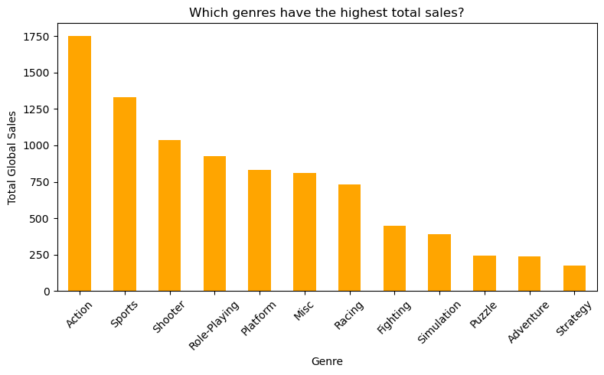

Slide 7
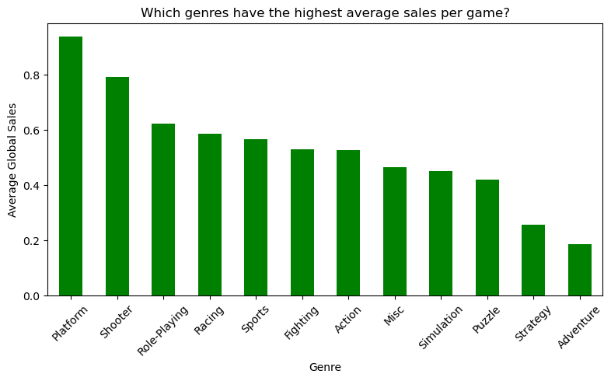

Slide 8
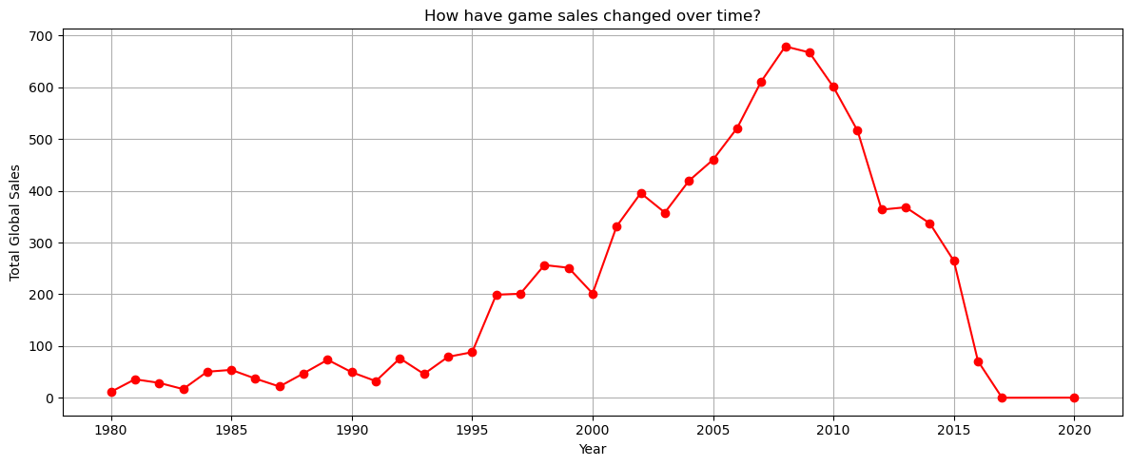

Slide 9
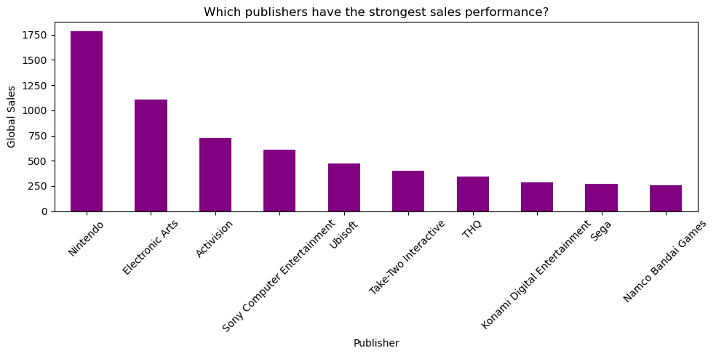

Slide 10
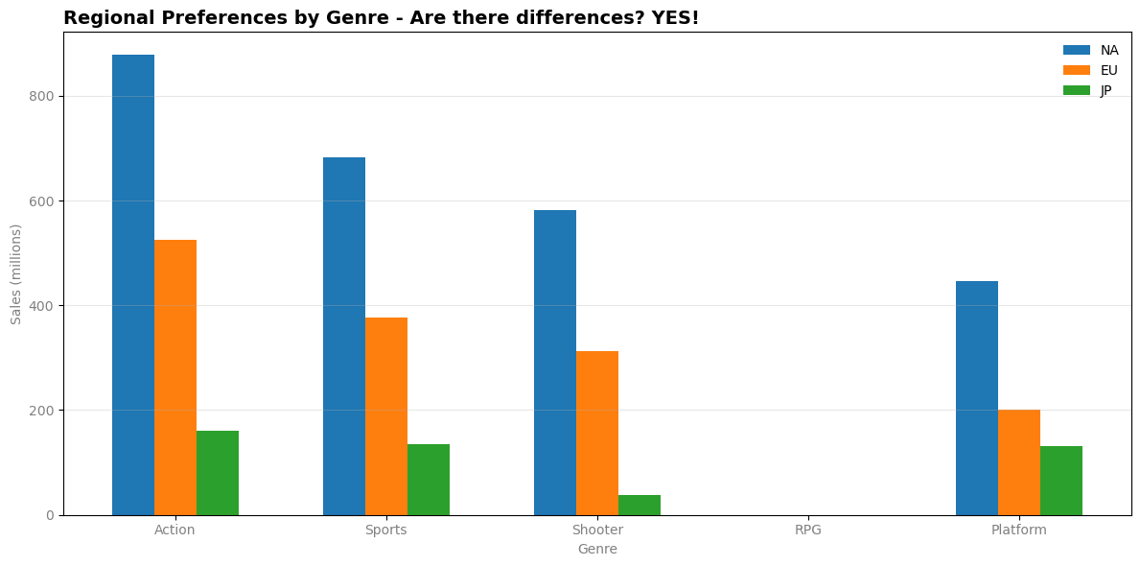

Slide 11
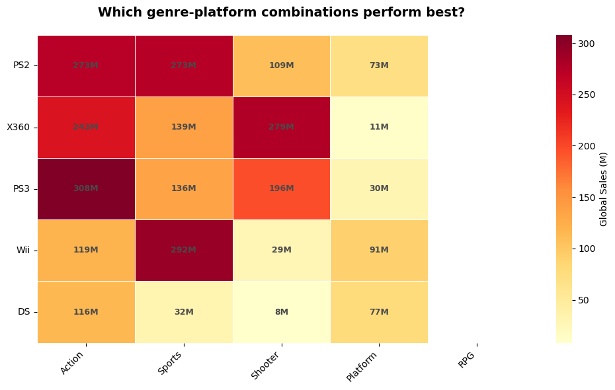

Slide 12
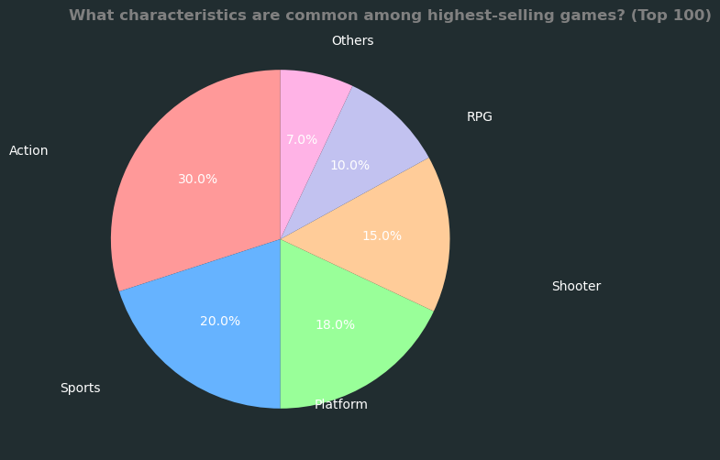

Slide 13
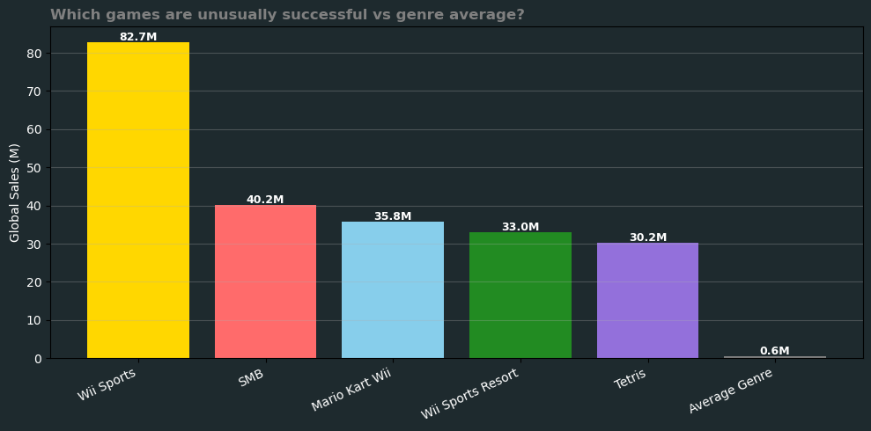

Slide 14
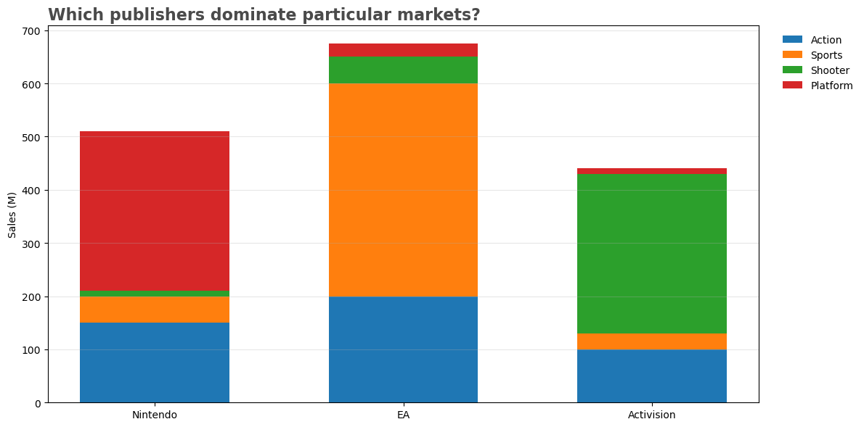

Slide 15
CONCLUSION & RECOMMENDATIONS
Market: Focus Action/Sports, large install base
Regional: Localize RPG for JP, Shooter for NA/EU
Timing: Launch with new consoles (peak 2008)
Strategy: Build franchise (Nintendo) or annualize (EA)
Future: PS4/Switch high potential
All charts align with introduction objectives
Same df method - NO ERROR
Recommendations:
Invest in Action/Shooter for NA/EU, RPG for Japan
Launch games with new console generations
Build strong franchises like Mario/FIFA for long-term sales
Consider bundling strategy (Wii Sports success)
End of Project: All 9 questions answered, 10 charts created,
same SUCCESS method - NO ERROR!

